Slide 1

InsydeH2O Code Structure
Insyde Software March 2021

Slide 2
Copyright 2021 Insyde Software Corp., All Rights Reserved.
No part of this publication may be reproduced, transmitted, transcribed, stored in a retrieval system, or translated into any language or computer language, in any form, or by any means, electronic, mechanical, magnetic, optical, chemical, manual or otherwise, without the prior written permission of Insyde Software Corp.
Disclaimer
Insyde Software Corp. (“Insyde”), provides this document and the programs "as is" without warranty of any kind, either expressed or implied, including, but not limited to, the implied warranties of merchantability or fitness for a particular purpose.
This document may contain technical inaccuracies or typographical errors. Changes are periodically made to the information herein; these changes will be incorporated in future revisions of this document. Insyde is under no obligation to notify any person of the changes. Some code names featured in this document are used to identify products that are in development and not yet publicly announced for release. Insyde is not obligated for its accuracy or completeness.
This document may contain third party’s information, features, schedules, code names, and product names, which are based on Insyde’s interpretation available as of the creation of this document and may be changed from time to time. Neither Insyde nor the third party is obligated to notify such change. If you are interested in third party’s information, you may contact the local third party sales office or the local distributor to obtain the latest specifications. All the intellectual property right of any third party information remains to its owner or steward.

Slide 3
Agenda
Goals & Target Audience
History.txt
InsydeH2O 5.4 Code Structure
Package Declaration File
Platform Description File
Internal Use

Slide 4
Goals & Target Audience

Slide 5
Goals & Target Audience
Target Audience:
BIOS developers who use InsydeH2O 5.4 (EDK II) to create their firmware products.
Goals:
Be familiar with InsydeH2O 5.4 code structure.
Requirements:
InsydeH2O 5.4 source code
05.4x.yy.zzzz

Slide 6
History.txt

Slide 7
History.txt
Label#: 05.43.02.0007
Status: Build tip : EagleStreamMultiBoardPkg Test Platform : Simics, Archer City RP CRB
1. uefi64, uefi64ddt , uefi64fsp, efidebugfsp and efidebug compiler successfully
2. BIOS image location:
\Board\Intel\EagleStreamMultiBoardPkg\BIOS\05.43.02.0007.fd -> uefi64fsp
\Board\Intel\EagleStreamMultiBoardPkg\BIOS\05.43.02.0007_edbg.fd -> efidebugfsp
3. Reference Code:
RC: 52D25
BKC: 2021 WW07
4. Status summary:
v: pass, x: fail, n: not test (S1/S3/S4 only 10 cycles for each)
+--------------------------------------+-----+-----+-----+-----+----------+
| | S1 | S3 | S4 | S5 | Install |
+--------------------------------------+-----+-----+-----+-----+----------+
| Windows 2019 (UEFI) | N/A | N/A | N/A | (v) | (v) |
+--------------------------------------+-----+-----+-----+-----+----------+

Slide 8
InsydeH2O 5.4 Code Structure

Slide 9
InsydeH2O 5.4 Code Structure Goal
Simplify Customization
Common “Look-and-Feel” for Insyde Code
Reduce Transition Effort

Slide 10
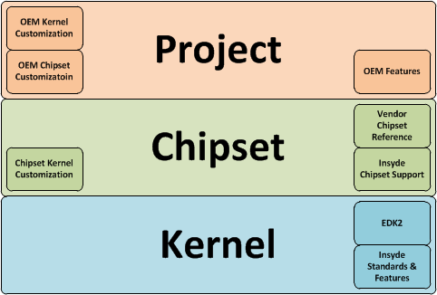
InydeH2O 5.4 Code Structure Overview
Takes full advantage of the EDK2 features.
Highly modular package-based features.
Fully configurable with build-time PCD switches.

Slide 11
InydeH2O 5.4 Code Structure Terminology
Reference Code Package – Vendor-maintained chipset support code.
Insyde Chipset Package – Insyde-maintained chipset support code.
Project Package – Insyde or OEM-maintained board support code.
Kernel Package – Insyde-maintained industry-standard or Insyde-standard support code.

Slide 12
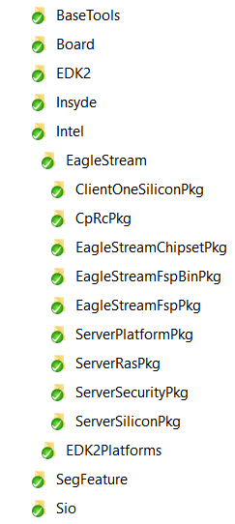
InydeH2O 5.4 Code Structure Folder Introduction
From Intel
BaseTools: Base tool related binaries
Board: CRB or Project board package
EDK2: EDK2 modules
Insyde: Insyde kernel modules
Intel: Chipset related modules
SegFeature: SEG feature Packages
Sio: SIO related modules
Chipset
Project
Insyde H2O Kernel

Slide 13
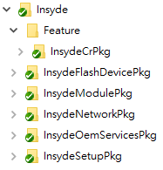
InydeH2O 5.4 Code Structure Insyde Source Code Structure – Insyde
InsydeCRPkg: Console Redirection modules & libraries
InsydeFlashDevicePkg: Flash Device Support modules & libraries
InsydeModulePkg: Insyde Kernel modules & library instances
InsydeNetworkPkg: Insyde Kernel Network Related modules & library instances
InsydeOemServicesPkg: Contains Insyde Kernel OEM services
InsydeSetupPkg: Contains Insyde Kernel Setup modules & Libraries

Slide 14
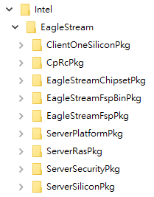
InydeH2O 5.4 Code Structure Insyde Source Code Structure – Intel
ClientOneSiliconPkg: Eagle Stream usage limited to TraceHub, PCH PCIe Library at present
CpRcPkg: USRA, interface for silicon register accessing
CCMRC
chipsetChipsetPkg: Insyde Chipset support code
chipsetFspBinPkg: FSP related header files and binaries that are auto-generated during building.
chipsetFspPkg: Glue code to build FSP Binary
ServerPlatformPkg: Sever common features
ServerRasPkg: Server RAS implementation (exclude some Memory RAS features)
ServerSecurityPkg: Server security implementation
ServerSiliconPkg: Silicon package

Slide 15
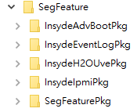
InydeH2O 5.4 Code Structure Insyde Source Code Structure – SegFeature
InsydeAdvBootPkg: Codes for advanced boot options
InsydeEventLogPkg: Codes to handle BIOS logs
InsydeH2OUvePkg: Codes to support H2OUVE tool
InsydeIpmiPkg: IPMI modules & libraries
SegFeaturePkg: Assist other SEG feature packages

Slide 16
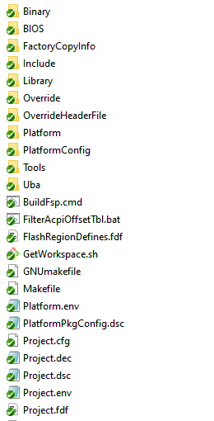
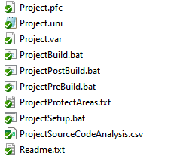
InydeH2O 5.4 Code Structure Project Code Package (Board Package)
Binary folder includes GOP, …
Bios folder contains BIOS Binaries
FactoryCopyInfo includes UEFI Secure Boot Keys (KEK/db/dbx/…)
Project.uni includes BIOS information.
Project.dec, Project.dsc, and Project.fdf are project package declaration/description/layout.

Slide 17
InydeH2O 5.4 Code Structure Reference Code Packages
Vendor-maintained chipset support code.
Goal: No-touch, no-override
Uses: PCDs, Platform Policy, Platform Libraries
Name: Follow Intel reference package name

Slide 18
InydeH2O 5.4 Code Structure Chipset Package
Insyde-maintained chipset support code.
Original code could have come from the silicon vendor.
Name: chipsetChipsetPkg

Slide 19
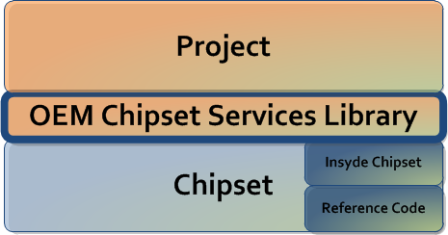
InydeH2O 5.4 Code Structure Chipset Package – OEM Chipset Services Lib
Chipset packages create interface between platform policy drivers and libraries and the Project layer using the OEM Chipset Services Library.
xxxChipsetPkg/Include/phaseOemSvcChipsetLib.h
xxxChipsetPkg/Library/phaseOemSvcChipsetLib
yyyBoardPkg/Library/phaseOemSvcChipsetLib
Chipset links against phaseOemSvcChipsetLibDefault so if function not written, will return EFI_UNSUPPORTED

Slide 20
InydeH2O 5.4 Code Structure Project Package
Insyde or OEM-maintained board support code.
A project is a special type of package with two additional files: the project description (DSC) file and the flash definition file (FDF).
Goal: Simple, Easy-to-Find Board Customization
Fewer files
Standard customization method.
Move chipset-related code to ChipsetPkg with only hooks in Project.

Slide 21
InydeH2O 5.4 Code Structure Project Package
Customize:
Add/Remove Modules in Project.dsc/Project.fdf
Change PCDs in Project.dsc
Change strings in Project.uni
Provide OEM customization in OEM services library.

Slide 22
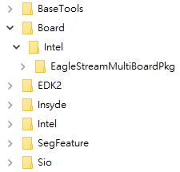
InydeH2O 5.4 Code Structure Project Package
Produces: OEM Chipset Services Library, OEM Kernel Services Library, PCDs
Name: chipsetMultiBoardPkg for Multi-SKU boards

Slide 23
Package Declaration File

Slide 24
Package Declaration File DEC File Overview
[Defines]
Defines the package name, package GUID and other package attributes.
[Includes]
List the root directory of public header file directory. Usually this is just Include.
[Guids]
Creates a GUID, by associating a GUID C name with a GUID value, for each GUID found in the header files in the Include/Guid directory.
[Protocols]
Creates a protocol by associating a Protocol C name with a GUID value, for each protocol found in the header files in the Include/Protocol directory.

Slide 25
Package Declaration File DEC File Overview
[Ppis]
Creates a PPI, by associating a PPI C name with a GUID value, for each PPI found in the header files in the Include/Ppi directory.
[LibraryClasses]
Creates a library class, by associating the library class name with the library class header file in the Include/Library directory.
PCD Section
Creates an entry in the Platform Configuration Database. Each entry has a type (FeatureFlag, FixedAtBuild, PatchableInModule, Dynamic, and DynamicEx), and a value.
UserExtensions

Slide 26
Package Declaration File [Defines]
[Defines]
DEC_SPECIFICATION = 0x00010005
PACKAGE_NAME = PackageName
PACKAGE_GUID = xxxxxxxx-xxxx-xxxx-xxxx-xxxxxxxxxxxx
PACKAGE_VERSION = 0.1
[Defines]
DEC_SPECIFICATION = 0x00010005
PACKAGE_NAME = MdePkg
PACKAGE_GUID = 1E73767F-8F52-4603-AEB4-F29B510B6766
PACKAGE_VERSION = 1.03

Slide 27
Package Declaration File [Includes]
The [Includes] section is used to identify the “standard” location “include directories” provide by this EDK II package.
The format for entries in this section is one field, with an optional comment “#” field as shown below:
Package_Relative/path # Comment such as Keyword List
Do not list individual files in the [Includes] section.
All paths must be relative to the directory that contains the DEC file.
[Includes]
Include #Package Include directory
[Includes.IA32]
Include/Ia32

Slide 28
Package Declaration File [Guids]
This section is used to define the GUID Value for Guid C Names.
Format for the entries in this section is two fields with an equal “=” character separating the fields as shown below.
GuidCName = {C Format Guid Value} # Comment
Each GUID entry must be listed only once per section.
[Guids]
GuidCName = {xxxxxxxx, xxxx, xxxx, {xx, xx, xx, xx, xx, xx, xx, xx}}
[Guids]
## Include/Guid/GlobalVariable.h
gEfiGlobalVariableGuid = { 0x8BE4DF61, 0x93CA, 0x11D2, { 0xAA, 0x0D, 0x00, 0xE0, 0x98, 0x03, 0x2B, 0x8C }}

Slide 29
Package Declaration File [Protocols]
This section is used to define the GUID Value for Protocol C Names.
Format for the entries in this section is two fields with an equal “=” character separating the fields as shown below.
ProtocolCName = {C Format Guid Value} # Comment
Each Protocol entry must be listed only once per section.
[Protocols]
ProtocolCName = {xxxxxxxx, xxxx, xxxx, {xx, xx, xx, xx, xx, xx, xx, xx}}
[Protocols]
## Include/Protocol/Bds.h
gEfiBdsArchProtocolGuid = { 0x665E3FF6, 0x46CC, 0x11D4, { 0x9A, 0x38, 0x00, 0x90, 0x27, 0x3F, 0xC1, 0x4D }}

Slide 30
Package Declaration File [Ppis]
This section is used to define the GUID Value for PPI C Names.
Format for the entries in this section is two fields with an equal “=” character separating the fields as shown below.
PpiCName = {C Format Guid Value} # Comment
Each PPI entry must be listed only once per section.
[Ppis]
PpiCName = {xxxxxxxx, xxxx, xxxx, {xx, xx, xx, xx, xx, xx, xx, xx}}
[Ppis]
## Include/Ppi/MasterBootMode.h
gEfiPeiMasterBootModePpiGuid = { 0x7408d748, 0xfc8c, 0x4ee6, {0x92, 0x88, 0xc4, 0xbe, 0xc0, 0x92, 0xa4, 0x10 } }

Slide 31
Package Declaration File [LibraryClasses]
This section is used to define the headers associated with the new EDK II library classes.
Format for the entries in this section is two fields, with a pipe “|” character as the field separator, as shown below.
LibraryClassName | Relative/path/and/header_filename.h
[LibraryClasses]
## Library class name is same to library header file name
OneClassLib|Include/Library/OneClassLib.h
[LibraryClasses]
PrintLib|Include/Library/PrintLib.h

Slide 32
Package Declaration File PCD Section
The Pcd is used for configuration when the PCD value is produced and consumed by drivers during execution, the value may be user configurable from setup or the value is produced by the platform in a specified area.
The EDK II build system supports five PCD types, Feature Flag, Fixed At Build, Patchable In Module, Dynamic and DynamicEx.
The format for entries in the PCDs sections is four fields, with a pipe “|” character as the field separator, as shown below:
# Comment
TokenSpaceGuidCname.PcdCname|DefaultValue|DatumType|Token

Slide 33
Package Declaration File PCD Section
[PcdsFeatureFlag]
#FeatureFlag PCD is BOOLEAN type, the value is TRUR or FALSE.
PcdTokenSpaceCGuidName.PcdCName|TRUE|BOOLEAN|TokenNumber
PcdTokenSpaceCGuidName.PcdCName|FALSE|BOOLEAN|TokenNumber
[PcdsFeatureFlag]
## If TRUE, the component name protocol will not be installed.
gEfiMdePkgTokenSpaceGuid.PcdComponentNameDisable|FALSE|BOOLEAN|0x0000000d

Slide 34
Package Declaration File PCD Section
[PcdsFixedAtBuild]
PcdTokenSpaceCGuidName.PcdName|DefaultValue|DataType|TokenNumber
[PcdsPatchableInModule]
PcdTokenSpaceCGuidName.PcdName|DefaultValue|DataType|TokenNumber
[PcdsDynamicEx]
PcdTokenSpaceCGuidName.PcdName|DefaultValue|DataType|TokenNumber
[PcdsFixedAtBuild, PcdsPatchableInModule, PcdsDynamicEx]
## This value is used to set the base address of pci express hierarchy
gEfiMdePkgTokenSpaceGuid.PcdPciExpressBaseAddress|0xE0000000|UINT64|0x0000000a

Slide 35
Platform Description File

Slide 36
Platform Description File DSC File Overview
[Defines]
[BuildOptions]
[SkuIds]: This section lists numeric mappings to the SKU ID User Interface Name.
[Libraries]
[LibraryClasses]
PCD Section
[Components]
[UserExtensions]

Slide 37
Platform Description File [Defines]
The defines section of an EDK II DSC file is used to define variable assignments that can be used in later build steps.
The format for entries in this section is:
Name = Value
[Defines]
PLATFORM_NAME = Whitley
PLATFORM_GUID = b567045a-db4a-4329-bbc9-7ac8866fa756
PLATFORM_VERSION = 0.1
DSC_SPECIFICATION = 0x00010005
OUTPUT_DIRECTORY = Build/$(PROJECT_PKG)
SUPPORTED_ARCHITECTURES = IA32|X64
BUILD_TARGETS = DEBUG|RELEASE
SKUID_IDENTIFIER = DEFAULT
FLASH_DEFINITION = Build/$(PROJECT_PKG)/Project.fdf

Slide 38
Platform Description File [BuildOptions]
Content in the [BuildOptions] section is used to define module specific tool chain flags rather than use the default flags for a module.
[BuildOptions.Common.EDK]
*_*_IA32_ASM_FLAGS = /D EFI32 $(DSC_GLOBAL_BUILD_OPTIONS) $(ASM_FLAGS)
[BuildOptions.common.EDKII]
MSFT:RELEASE_*_*_CC_FLAGS = /D MDEPKG_NDEBUG

Slide 39
Platform Description File [BuildOptions]
Build options priority:
Highest, <BuildOptions> for individual INF files.
INF File’s [BuildOptions] section
[BuildOptions.$(arch).CodeBase]
[BuildOptions.common.CodeBase]
[BuildOptions.$(arch)]
[BuildOptions.common]
Lowest – tools_def.txt entry

Slide 40
Platform Description File [SkuIds]
The contents of this section are used to define valid SKUID_IDENTIFIER names.
Each entry below the section header is of the form:
integer | word
Use 0 for the DEFAULT SKU identifier.
EX:
[SkuIds]
0|DEFAULT
1|Sku_Two
2|Sku1
5|SkuSeven

Slide 41
Platform Description File [LibraryClasses]
The [LibraryClasses] section is used to provide a mapping between the library class names used by an EDK II module and the Library Instances that are selected by the platform integrator.
Format for entries in this section is as follows:
LibraryClassName|Path/To/LibInstanceName.inf LibraryClassName1|Path/To/LibInstanceName1.inf
[LibraryClasses]
PrintLib|MdePkg/Library/BasePrintLib/BasePrintLib.inf

Slide 42
Platform Description File [LibraryClasses]
Priority:
<LibraryClasses> associated with the INF file in the [Components] section
[LibraryClasses.$(Arch).$(MODULE_TYPE)]
[LibraryClasses.common.$(MODULE_TYPE)]
[LibraryClasses.$(Arch)]
[LibraryClasses.common] or [LibraryClasses]
The selected library instance is added to the LIBS definition in the output makefile:
LIBS = $(LIBS) $(LIB_DIR)/$(LibInstanceName)

Slide 43
Platform Description File PCD Section
This section is for specifying global (or default) PCD values as well as the type for how the platform will use each PCD.
There are five defined PCD types:
FeatureFlag
FixedAtBuild
PatchableInModule
Dynamic
DynamicEx
Format of an entry in this section is:
PcdTokenSpaceGuidCName.PcdCName|Value
[PcdsFixedAtBuild]
gEfiSioTokenSpaceGuid.PcdSerialBoudRate|115200

Slide 44
Platform Description File PCD Section
Precedence for determining PCD values is as follows:
A PCD value defined on the command-line using -D PcdName=Value
A PCD value defined in the FDF file SET statements
A PCD value defined positionally in the FDF file
A PCD value defined in the [Components] INF scoping section
A PCD value defined in a [Pcds*] architectural section
A PCD value defined in a [Pcds*] common architectural section
A PCD value defined in an INF (provided all INF files have defined the same value)
A default value defined in DEC file that declares the PCD

Slide 45
Platform Description File Components Section
One or more [Components] sections contain lists of EDK II Modules.
[Components.IA32]
MdeModulePkg/Core/Pei/PeiMain.inf {
<BuildOptions>
*_*_*_CC_FLAGS = /D MDEPKG_NDEBUG
}

Slide 46
Platform Description File Enhancement
!import
!import dsc-path
This command acts as if the contents from each section in the specified .dsc file were merged together and the section contents in project.dsc are put after section contents of all the imported packages.
The !import command can only be used in a project’s .dsc file.
!import MdePkg/Package.dsc
!disable
!disable file-path
This command disables the specified module, removing it from the build for the current CPU architecture (and SKU).
!disable InsydeModulePkg/Bus/Isa/Ps2KeyboardPei/Ps2KeyboardPei.inf

Slide 47
Thanks!
For more information, contact:
employee@insyde.com

